Slide 1
HAVE FAITH IN THE LORD
(Lamentations 3:19-26; 2Tim.1:1-14; Luke 17:5-10)
By
Rev. Dr. Enoch Aryee-Atta

Slide 2
Introduction
Occasion: Ministers’ Appreciation Day
Life is full of many challenges and difficult situations:
  Loss of loved ones and breadwinners of families;
  Loss of employment and business failures;
  Fear of remaining single for life;
  Problems in marriages – Childlessness ; Threat of Divorce.
It is for these uncertainties that we are being encouraged to: “Have Faith in the Lord” to help us out.

Slide 3
Outline
What is Faith?
Why and when Do We Need Faith?
How Do We Obtain Faith?
How do We Show our Living Faith?

Slide 4
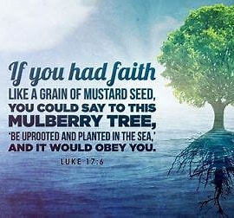

Slide 5
What is Faith?
Dictionary:
  Belief in a declaration by another based on testimony.
  Belief, trust, loyalty to a creed or religion.
Bible: Faith is the substance of things hoped for, the evidence of things not seen – Hebrews 11:1 ->
  The belief in the facts and truth of the scriptures about the person and work of Christ which makes one a true Christian.
  Confidence in the trustworthiness of Christ, regardless of current emotions or experiences.
  Complete trust in and total obedience to God.

Slide 6
Why Do We Need Faith?
Faith enables human beings to please God - Heb. 11:6 – “ But without faith, it is impossible to please God. Those who come to God must believe that He exists, and that he rewards those who diligently seek him”
Faith in God is necessary for our salvation.
We cannot relate with the invisible God without faith.

Slide 7
When Do We Need Faith?
In our daily walk with the Lord
Without faith we cannot please God – Hebrews 11:6
In moments of difficulty and despair - Isaiah 35:3-7
There was serious moral and spiritual decadence in Israel.
Israel/Judah indulged in pagan worship.
They violated God’s covenant with them.
God’s judgement came upon them and both Judah and Israel were captured by their enemies and exiled .

Slide 8
God’s Message of Hope to Israel
Strengthen the weak hands and the feeble knees.
Say to the fearful hearted, be strong do not fear.
God promised to come with vengeance to save and heal the blind, deaf, lame and also to restore.
Note: Isaiah’s prophesy was intended to lay a basis for hope for the faithful remnant of Israel.
  How can a hopeless people in captivity believe this prophecy?
  They must have faith in the lord.

Slide 9

Where Do We Obtain Faith From?
The Divine Side: Faith is a gift from the Triune God:
  Rom 12:3 – “Think of yourself with sober judgment, according to the faith God has given to each of you”
  Heb. 12:2 – “ Looking unto Jesus, the author and finisher of our faith …”
The Human Side: Faith is built upon: Romans 10:17 – Faith comes by hearing, and hearing by the word of God.
  Hearing, studying, memorizing, meditating.
Faith in God can be imparted to others: 2 Tim 1:5-8
  Lois (Grandma) -> Eunice (Mother) -> Timothy (Child)

Slide 10
The Two Kinds Of Faith: James 2: 14-17
James 2:17 - “ So then, faith by itself if it does not have works is dead.”
Dead Faith: Faith without works - An empty claim or an acceptance of a creed (summary of beliefs).
Living Faith: Faith backed by works – A belief in the Lord which produces an obedient lifestyle - works.

Slide 11
Lamentations 3:19-26
19 Remember my affliction and roaming, The wormwood and the gall. 20 My soul still remembers And sinks within me. 21 This I recall to my mind, Therefore I have hope. 22 Through the Lord's mercies we are not consumed, Because His compassions fail not.
23 They are new every morning; Great is Your faithfulness. 24 "The Lord is my portion," says my soul, "Therefore I hope in Him!" 25 The Lord is good to those who wait for Him, To the soul who seeks Him. 26 It is good that one should hope and wait quietly For the salvation of the Lord.
Notes:
ik

Slide 12
God’s Unfailing Faithfulness
Lamentations 3:19-26
The book of Lamentations is made up of, “laments,” which means to “cry out loudly to God.”
We lament when we go through tragic situations:
Losing a loved one,
Losing job, money(banking clean up);
Business Challenges
Ill-health.

Slide 13
Lesson about Love &Life
V. 22a A Lesson About Love (Mercies)
The Scope Of God's Love: He loves us above all…
The Strength Of God's Love: Boundless/eternal.
The Source Of God's Love: God is love.
V. 22b-23a A Lesson About Life (Compassion)
V. 22b God's Grace Is Sufficient: God gives us strength.
V. 23a God's Grace Is Specific: God's grace is as fresh.

Slide 14
V. 23b A Lesson about the Lord
Faithfulness: God’s faithfulness is revealed in:
  His Presence: Always present with Us.
  His Performance: God is greater than all.
  His Provision: God meets our needs-Php. 4:19
  His Person: God is reliable at all times-Heb. 13:8

Slide 15
2 Timothy 1:1-14
Greeting and introduction.
(1-5) A letter from Paul to Timothy: Spiritual family
  Grace, mercy, and peace; Paul prayed for Timothy night/day
2. Grandmother Lois and your mother Eunice:
  Timothy from Lystra (Paul’s 1st mission (Acts 14:16-20)
  Paul returned to Lystra and met Timothy was devoted to serving the Lord (Acts 16:1-5).
  Timothy’s grand mum/mother believed in Jesus, but his father who was Greek did not.
Paul mentored Timothy in the Faith:
  To stir up the gift of God which is in him
  God has not given us a spirit of fear

Slide 16
The Attitude of Faith
A determined and thoughtful attitude.
An attentive attitude – watching & waiting.
A patient attitude – A solitary position if need be.
A humble and submissive frame of mind.
Seeing the vision by faith – The just shall live by faith
Declaring the vision as certain:
  Write it down for permanence and reference.
  Make it plain that the runner may read it.
  Make it practical so that the reader may run in response.

Slide 17
Jesus’ Teaching: Luke 17:1-4
Jesus told them to be on guard so that they would not cause any young believers in Him to stumble.
Jesus said that if their brother sinned, they were to rebuke him and if he repented they were to forgive him, no matter how often the cycle was repeated.
The disciples instantly realized that these were tough demands. To walk uprightly so as not to cause a new believer to stumble and to forgive someone who has wronged us are not automatic behaviours.
Forgiveness especially is tough because our feelings are involved.

Slide 18
The Results of Faith - Luke 17:5-10
⁵ The apostles said to the Lord, “Increase our faith!”
⁶ He replied, “If you have faith as small as a mustard seed, you can say to this mulberry tree, ‘Be uprooted and planted in the sea,’ and it will obey you.
⁷ “Suppose one of you has a servant plowing or looking after the sheep. Will he say to the servant when he comes in from the field, ‘Come along now and sit down to eat’? ⁸ Won’t he rather say, ‘Prepare my supper, get yourself ready and wait on me while I eat and drink; after that you may eat and drink’? ⁹ Will he thank the servant because he did what he was told to do? ¹⁰ So you also, when you have done everything you were told to do, should say, ‘We are unworthy servants; we have only done our duty.’”

Slide 19
The Disciples’ Reaction: Luke 17:5-6
The disciples respond by asking the Lord to increase their faith (17:5).
It was an honest request stemming from the right motives. They saw that if they wanted to fulfil these demands, they would need God’s strength.
But Jesus’ answer (17:6) indicates that more faith is not really the issue. Faith is not measured by its quantity, but simply by its presence. A mustard seed sized faith will accomplish impossible things.

Slide 20
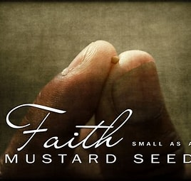
Mustard Seed Faith

Slide 21
The Disciples’ Reaction: Luke 17:7-10
Jesus says the real need is for more obedience and humility.
We should view ourselves as God’s slaves who owe Him simple and unquestioning obedience.
When we have done what He requires, we should not get puffed up with pride in our great obedience, but should simply say, “We are unworthy slaves; we have done only that which we ought to have done.”

Slide 22
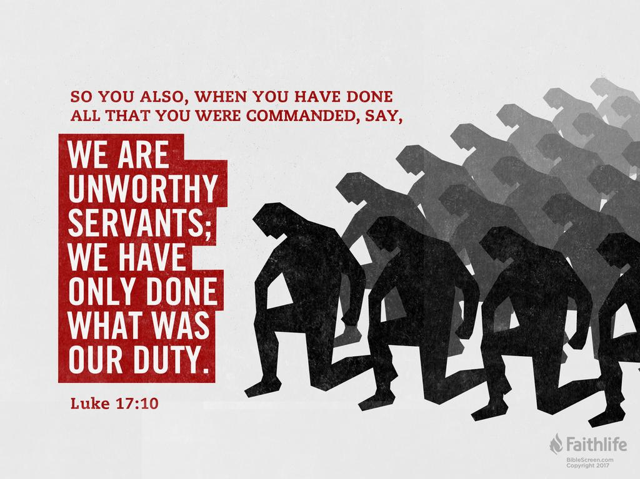

Slide 23
Results of Faith
Salvation by grace through Faith – Eph. 2:8, Rom 4:3;
Justification by Faith – Romans 5:1;
Sanctification by Faith – Acts 26:18.
Doing Exploits for the Lord – Hebrews 11:
  Faith is the key that unlocks the power of God;
  Faith is the antennae that accesses the resources of God.
Genuine faith in God will produce major results that will uproot and destroy competing loyalties.

Slide 24
Conclusion
Faith is putting confidence in the Lord our God .
Faith is believing and acting on the Word of God.
The Word of God becomes effective in our lives only when we mix it with faith – Hebrews 4:2.
Let us have faith in the Triune God – the Creator, the Redeemer and Sustainer of our lives.

Slide 25
SONG: Great is Thy Faithfulness - 1
Great is Thy faithfulness, O God my Father
There is no shadow of turning with Thee
Thou changest not, Thy compassions, they fail not
As Thou hast been, Thou forever will be
Great is Thy faithfulness
Great is Thy faithfulness
Morning by morning new mercies I see
All I have needed Thy hand hath provided
Great is Thy faithfulness, Lord, unto me

Slide 26
SONG: Great is Thy Faithfulness - 2
Summer and winter and springtime and harvest
Sun, moon and stars in their courses above
Join with all nature in manifold witness
To Thy great faithfulness, mercy and love
Great is Thy faithfulness
Great is Thy faithfulness
Morning by morning new mercies I see
All I have needed Thy hand hath provided
Great is Thy faithfulness, Lord, unto me

Slide 27
SONG: Great is Thy Faithfulness - 3
Pardon for sin and a peace that endureth
Thine own dear presence to cheer and to guide
Strength for today and bright hope for tomorrow
Blessings all mine with 10,000 beside
Great is Thy faithfulness
Great is Thy faithfulness
Morning by morning new mercies I see
All I have needed Thy hand hath provided
Great is Thy faithfulness
Great is Thy faithfulness
Great is Thy faithfulness, Lord, unto me

